Slide 1
Subsystem Breakdown Description and Examples
Data Communication/Storage - Manny
-Sending data from ESP32 to database
-Choose method to send data ex. MQTT, HTTP
-Choose database to hold data ex. Local excel, influxDB, google sheets
Machine learning
Model & training data - Andrew
-ML model type used to disaggregate data ex. linear regression, decision trees
-Verifying model accuracy against existing models
-Finding source of reliable training data to compare against
Data Processing and Pipelining - Labib
- Getting external data sources (REDD, UKDale) into usable forms
-Preprocessing data before it goes to ML model ex. remove errors, add weather data from online
-Sending processed data to ML model from database
-Sending ML data from model back to database or website
Website/User interface - Ralph
-Displaying data on new website or existing dashboard ex. Grafana, sheets
-Allowing user inputs/view customization ex. input power cost, date range
-Could include how a users data is linked to them ex. over wifi, account login, user ID
-Option of mobile view

Slide 2
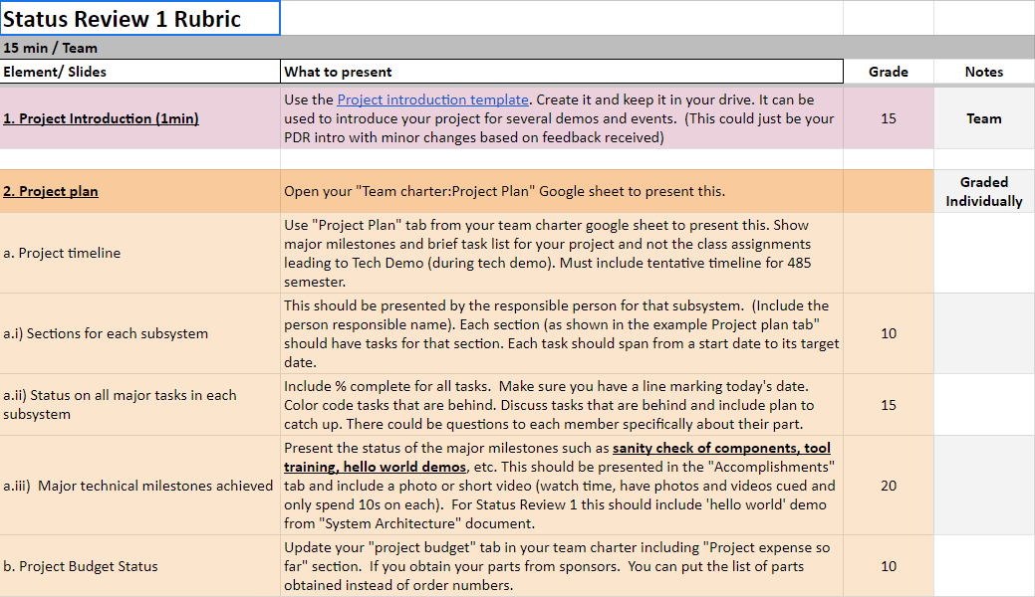
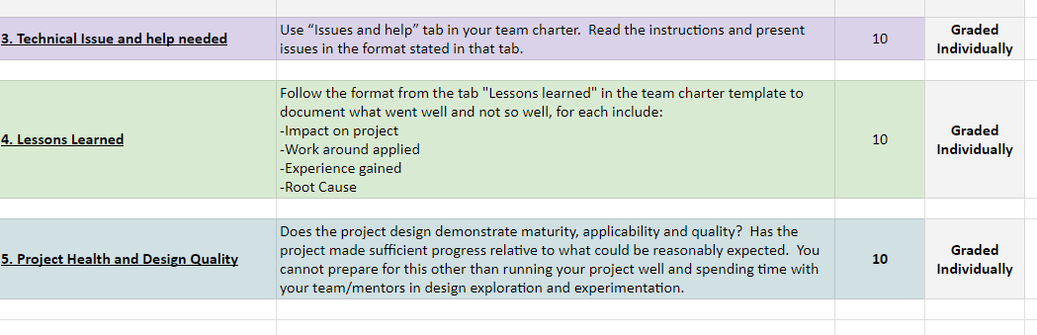
Requirements
Status Review 1

Slide 3
Status Review 1
Residential Power Disagreggation Team 50
Team Members
Andrew Bailey, Ralph Cullom, Manny Harris, Labib Kasim
Mentor - Sponsor
Huangjie Gong - ABB

Slide 4
Project Introduction
Our project is creating a cost-effective, IoT-driven system to be employed by consumers which will disaggregate various residential loads. This device will incorporate machine learning and advanced data processing techniques to break down and forecast residential load across different categories based on the aggregated measurement, then display them for the user.
Key features:
Device measures lumped power usage of a household.
Data that the device collects should be sent wirelessly back to online data storage through IoT.
Machine learning algorithms will take the data and weather as inputs and output the disaggregated loads and predicted use.
Measured and predicted data will be displayed to the user.
Key constraints:
Final cost of the product should be no more than $100.
Device shall be small enough to fit neatly inside the residential panel.

Slide 5
Hello World Demos and
Accomplishments

Slide 6
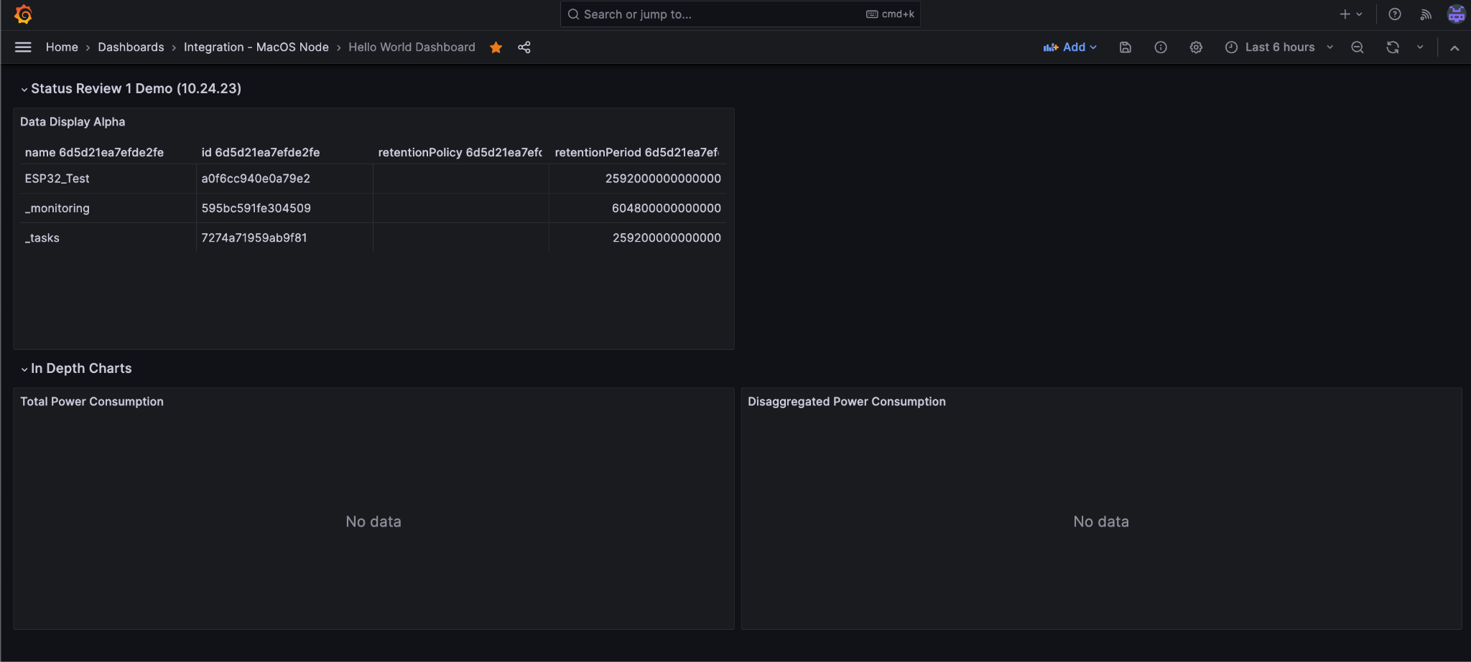
Ralph - Website / UI
Grafana Model

Slide 7
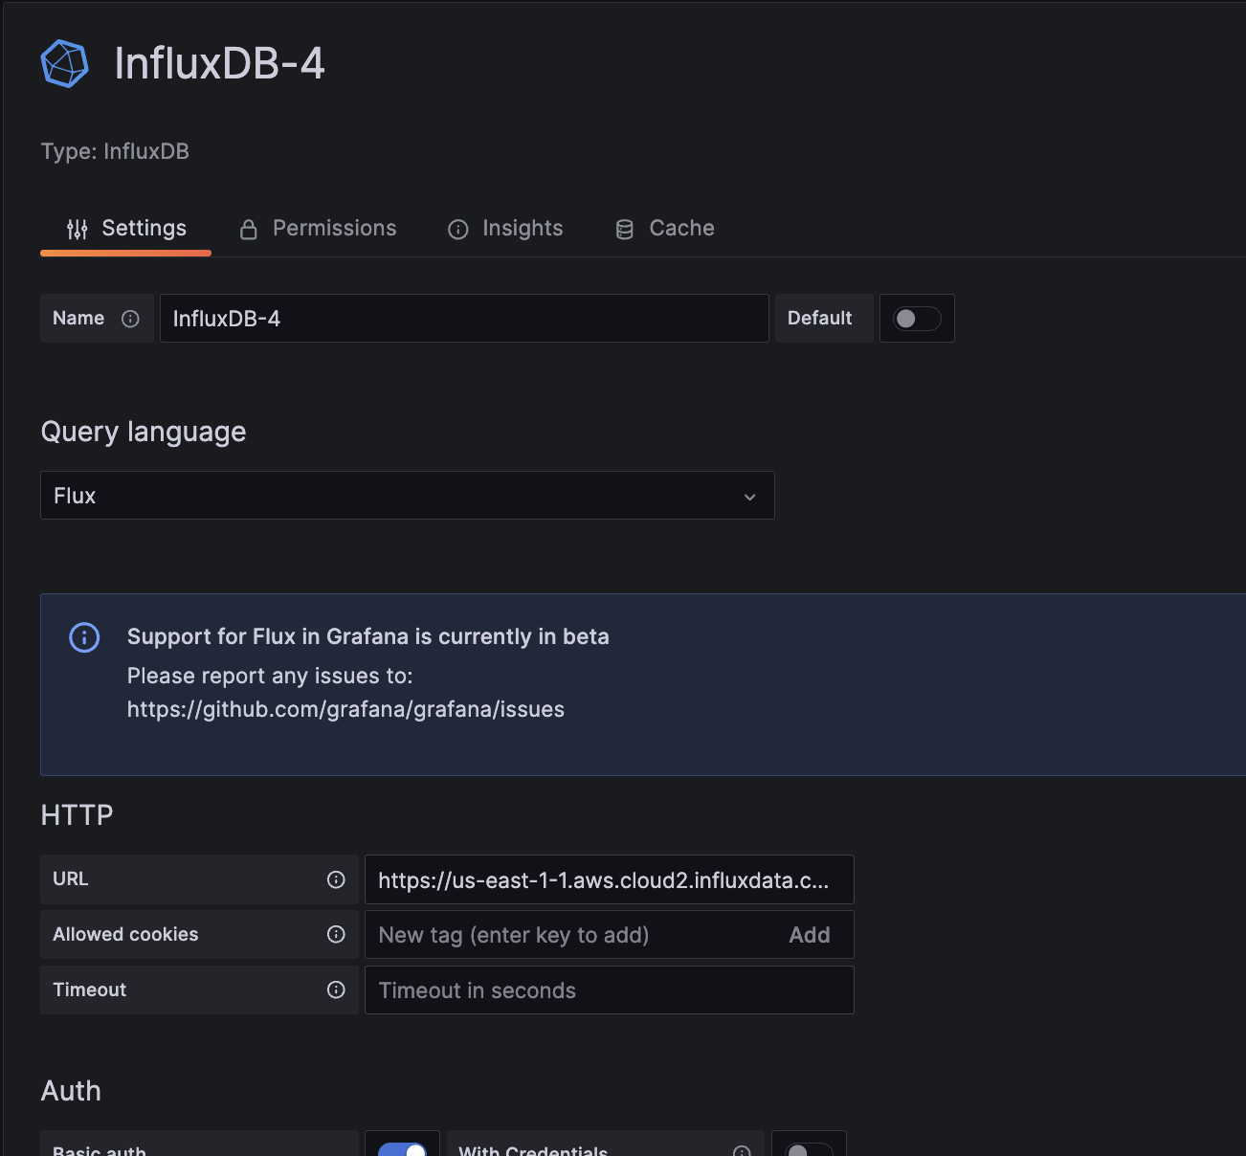
Ralph - Website / UI
Software is always easy to use and never a problem
(Kidding!)
Failed to connect initially, attempted to use .csv files
Requires an understanding of database manipulation

Slide 8
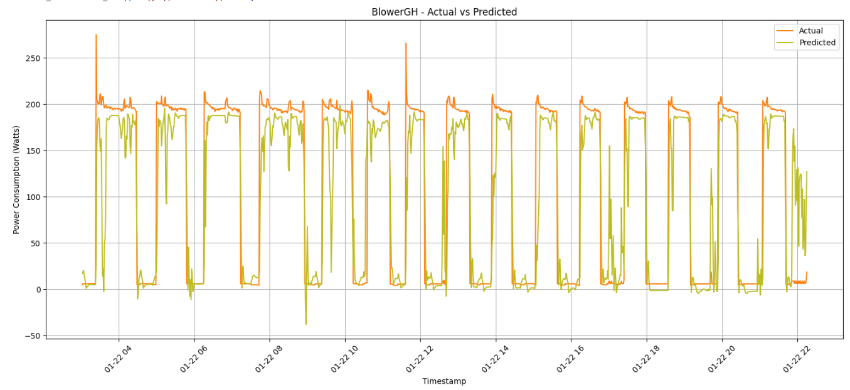
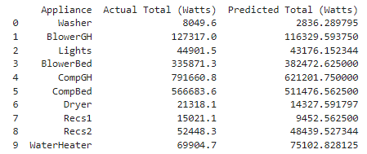
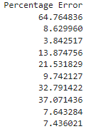
Andrew - ML Model
CNN LSTM Model
Convolutional Neural Networks & Long Short Term Memory
Total data only over 4 days
-96 hours
-5776 data rows
80/20 - training/testing split
-only 3.2 days of training data
-76.8 hours
-4608 data rows

Slide 9
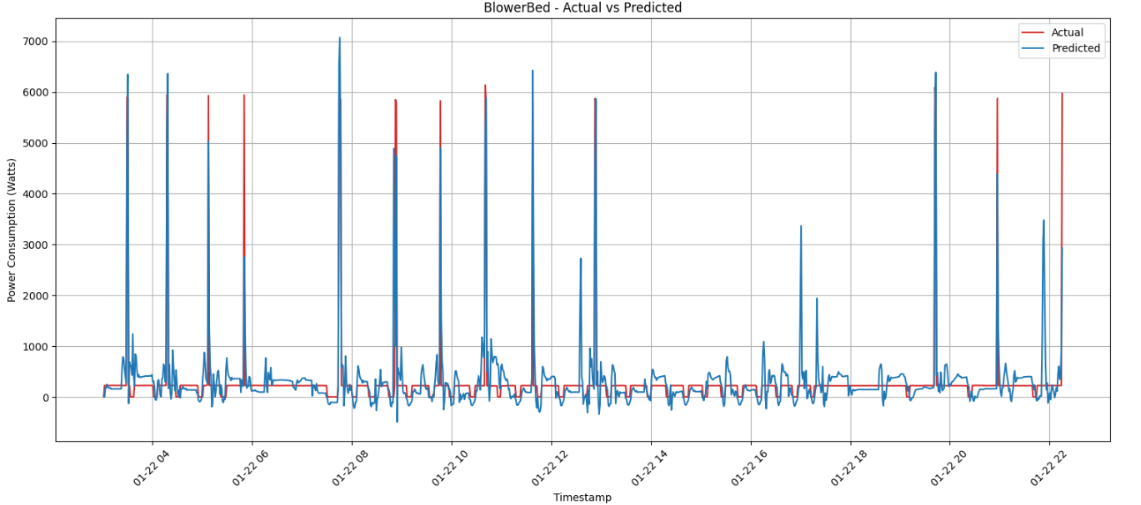
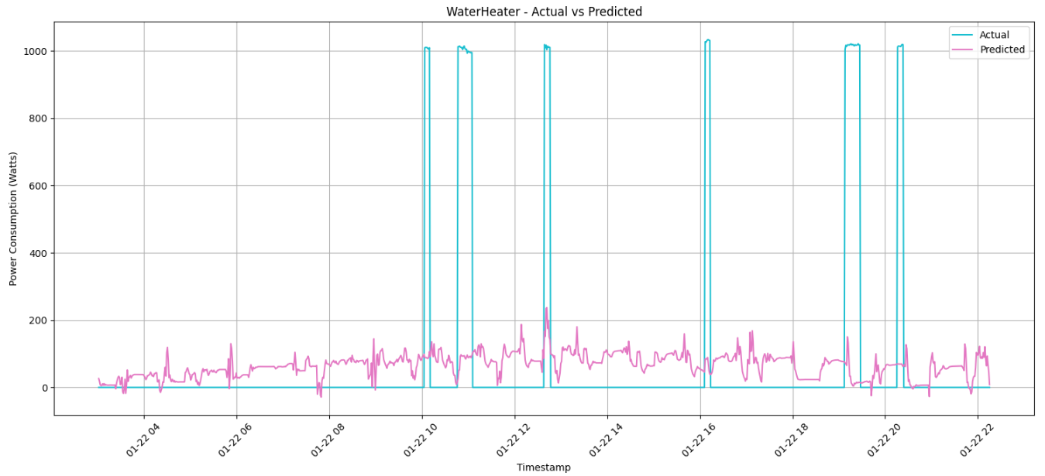
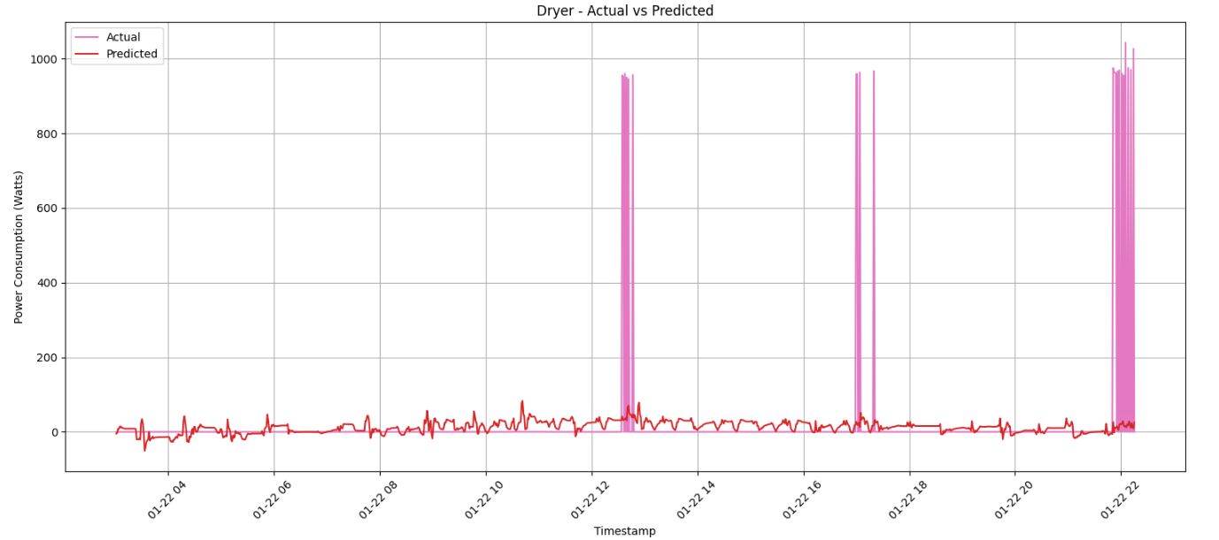
Andrew - ML Model
Some predictions better than other
-Randomness
-Length of training
-Complexity of signals
-LSTM drawback

Slide 10
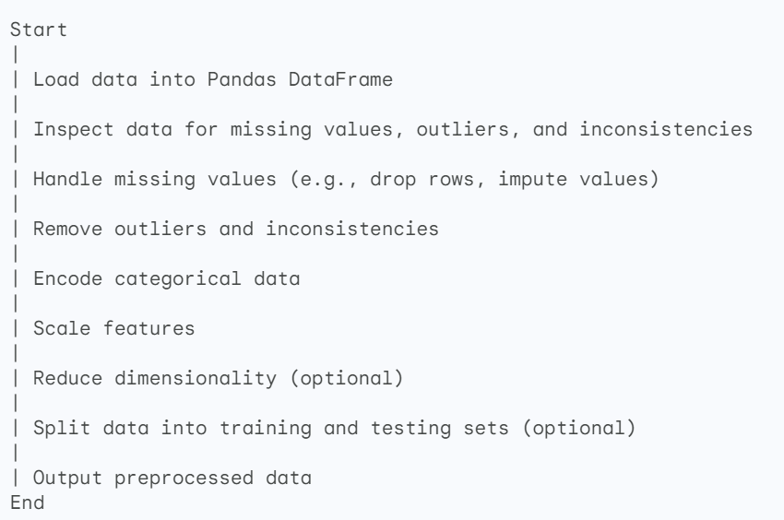
Labib - Data Preprocessing & Weather
PANDAS - Python Library for pre-processing data
Data Import: Pandas can read data from various file formats, making it easy to load raw data into a DataFrame.
Data Cleaning: Handle Missing Values: Pandas provides methods to remove or impute missing data.
Data Export: Save preprocessed data back to various file formats for further analysis or modeling.
Data Filtering and Selection: Easily filter rows based on specific criteria or select specific subsets of data.
Text Data Preprocessing: Pandas can be used in conjunction with other libraries for tasks like text cleaning, tokenization, and stopwords removal.

Slide 11
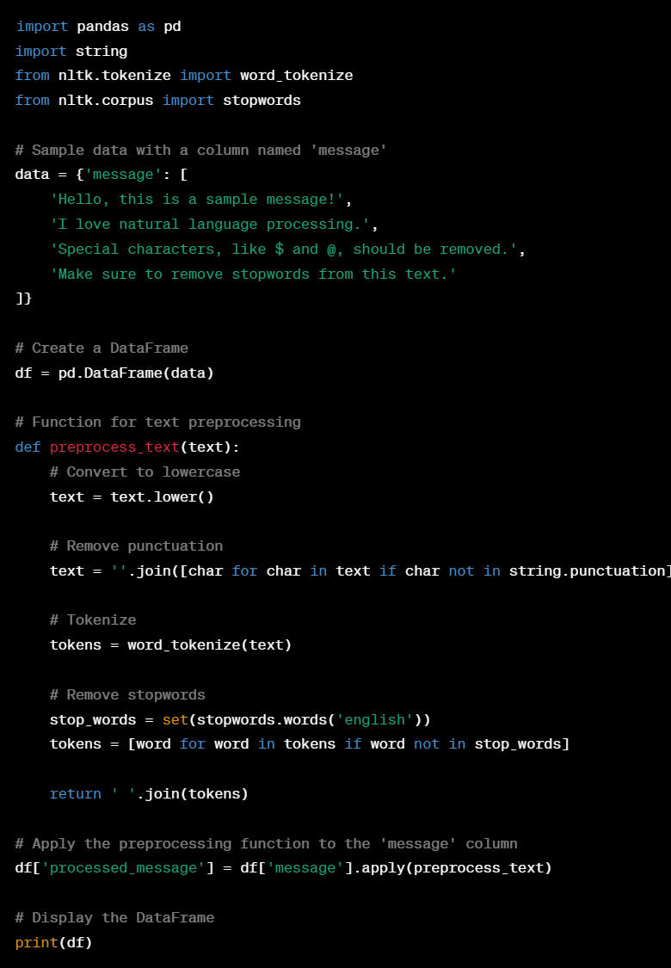
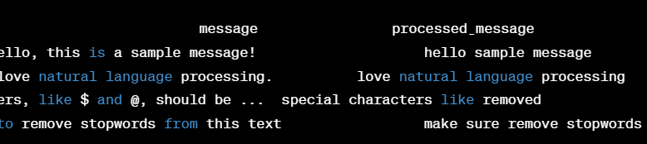
Example Code snippet
Output

Slide 12
Potential way of retrieving weather data
OpenWeatherMap - widely used platform that provides weather data, including current weather, forecasts, and historical data
Sign Up and Get an API Key: required to access their weather data.
Use Python to Access the API: used for retrieving data
Once you've obtained the weather data, you can combine it with your pre-processed data using Python and Pandas

Slide 13
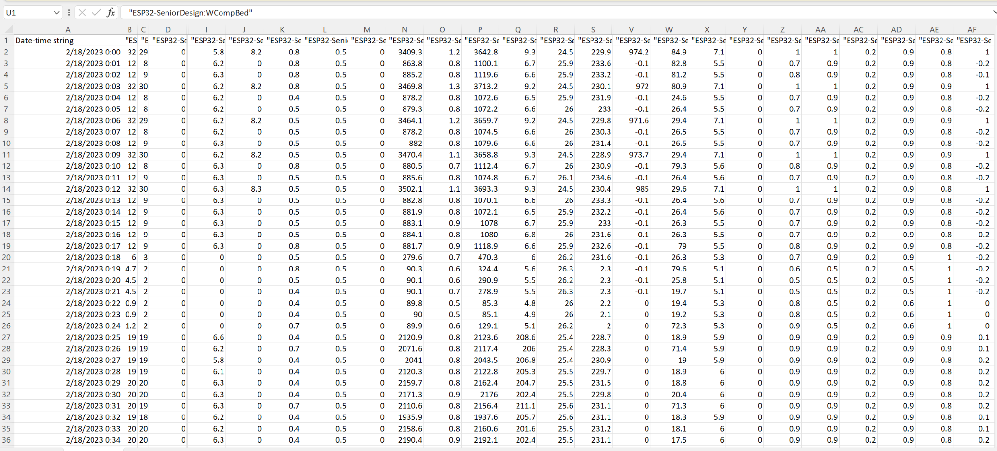
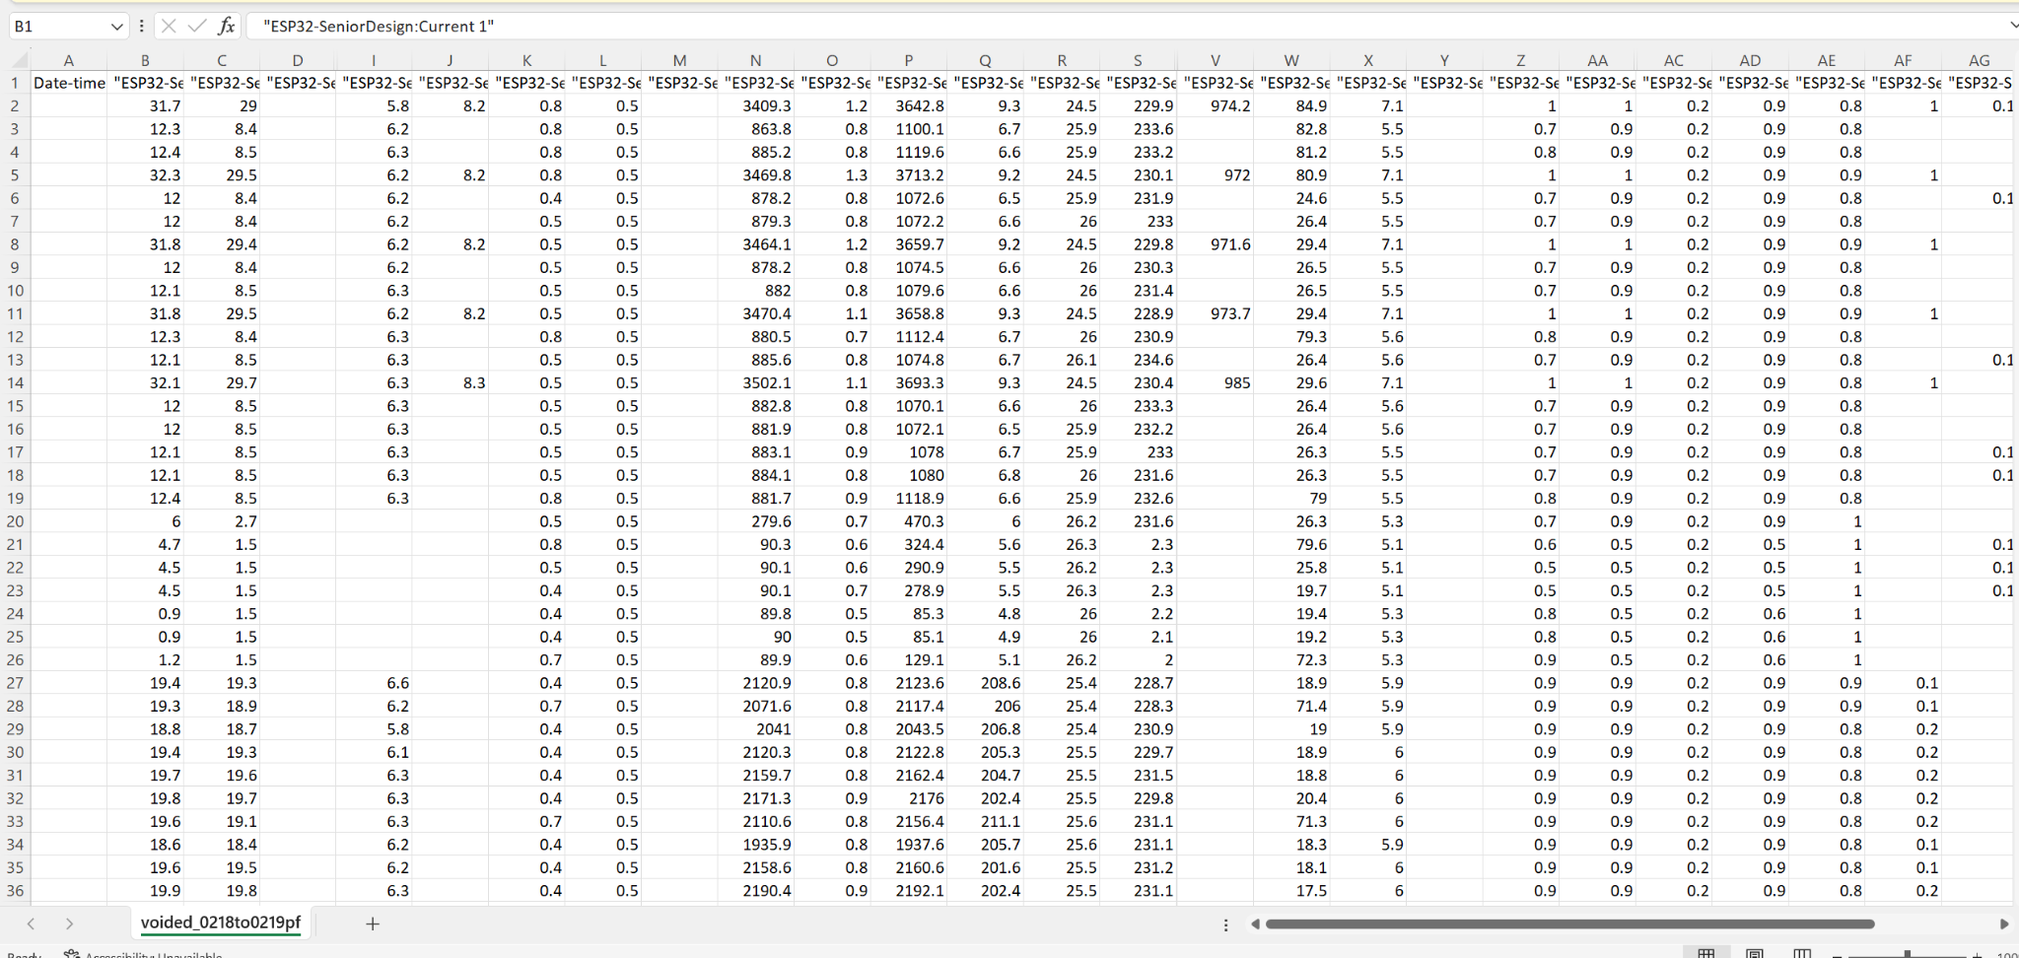
Status Review 2
BEFORE AFTER

Slide 14
Status Review 2
BEFORE AFTER

Slide 15
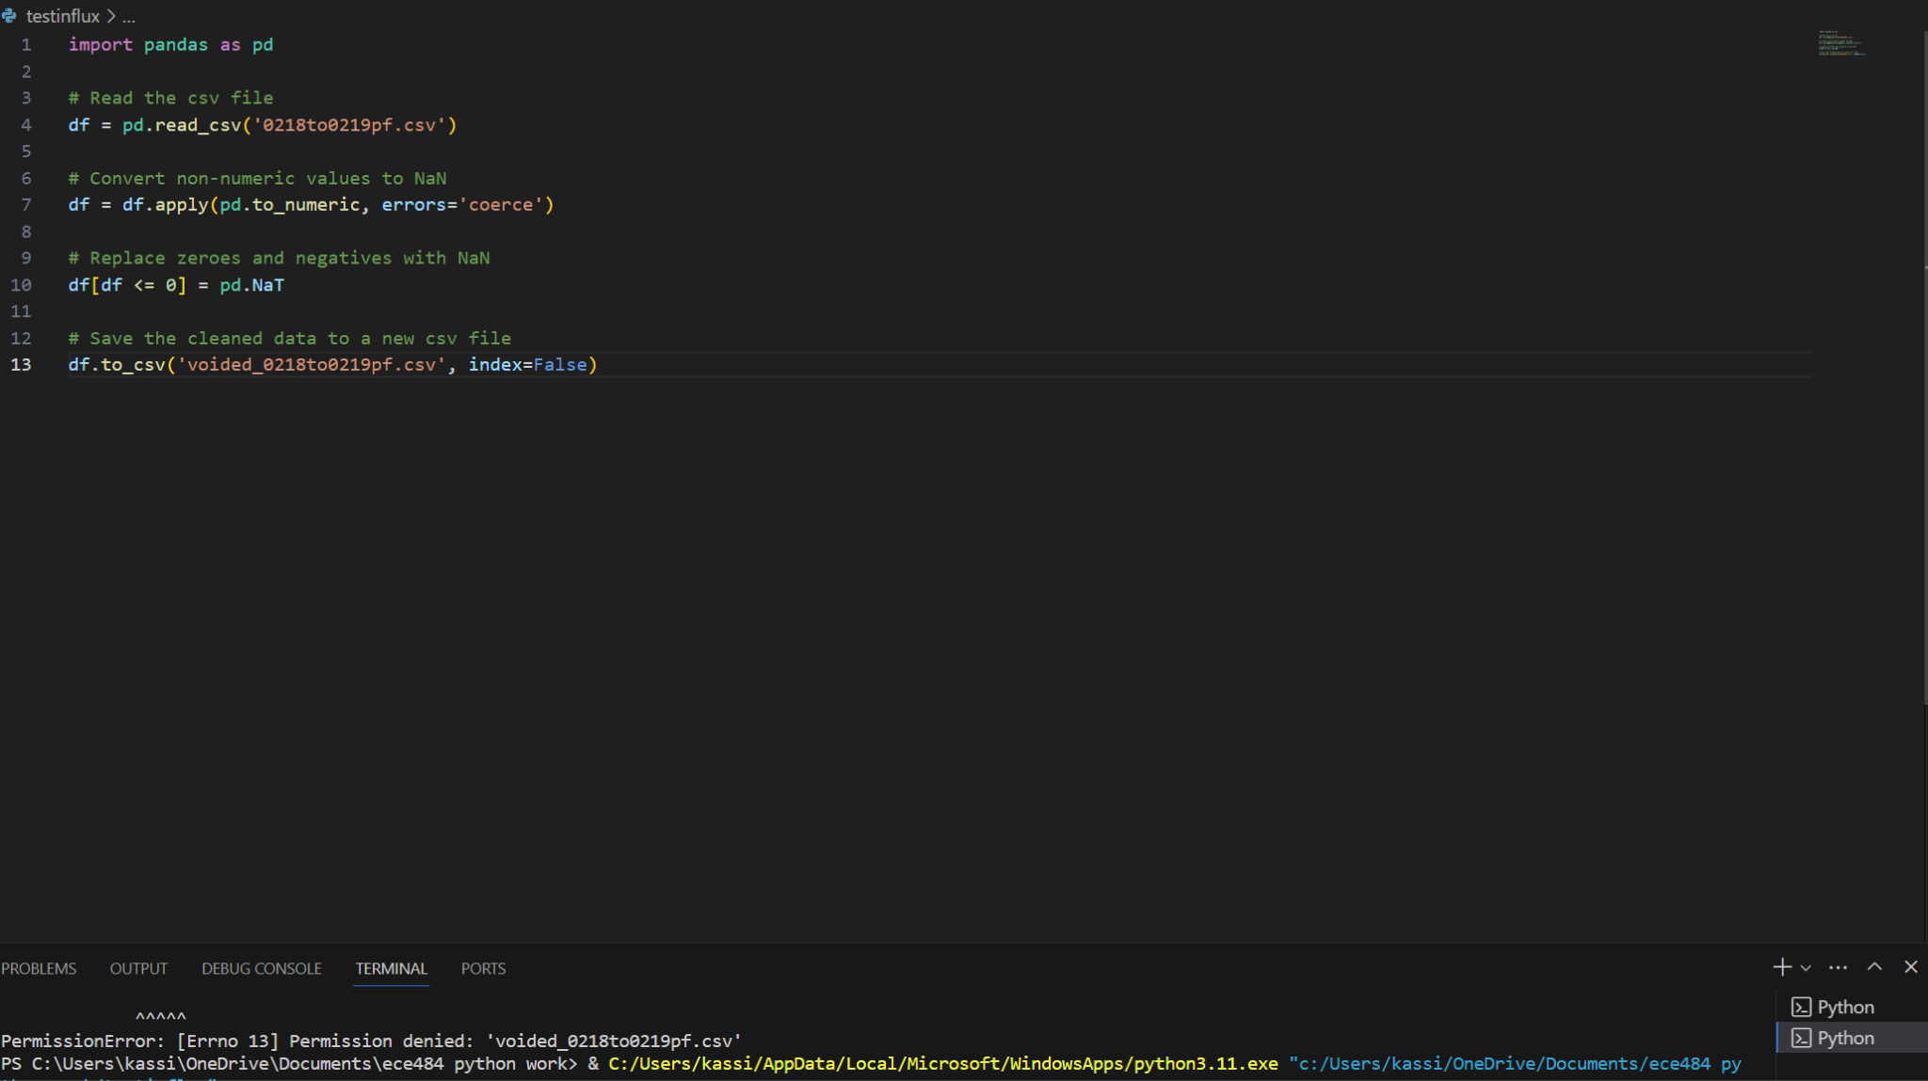
Snippet of code and problems currently
Code right now voids out all non-numeric values in file.
The date and time section shouldn’t be voided out
Notes:
Next steps:
Find an open source weather tool and figure out how to merge with data
Add up all columns giving individual power level of each appliance and get the total power utilized.

Slide 16
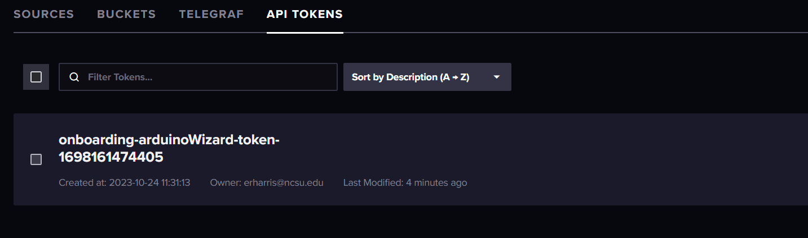
Manny - Data Communication
Code snippet showing URL, Token, ORG, and Bucket
#define INFLUXDB_URL "https://us-east-1-1.aws.cloud2.influxdata.com"
#define INFLUXDB_TOKEN "RgdkjEukPmIzSmY1WBp3v90Yond7X-kSP0rRq8LA8Uv0COI0pOw_Qdxw5gCVTrqYX2hjuT9KZpKFuCmZNGJpiQ=="
#define INFLUXDB_ORG "6d5d21ea7efde2fe"
#define INFLUXDB_BUCKET "ESP32_Test"

Slide 17
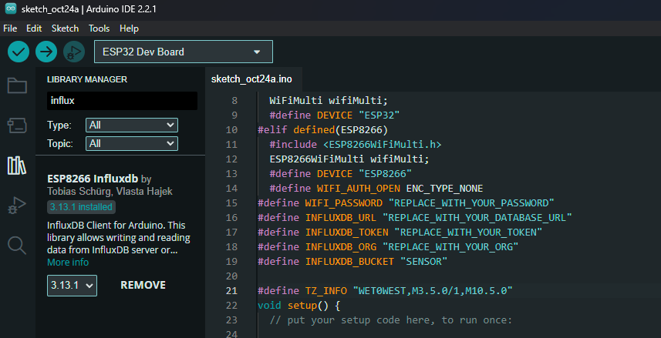
Connecting ESP32 & InfluxDB
Trouble with Arduino IDE compatibility
Ned to find a library that works with the current sensors
Tried to use ESP8266 InfluxDB library
Using Arduino IDE to send sensor reading to InfluxDB

Slide 18
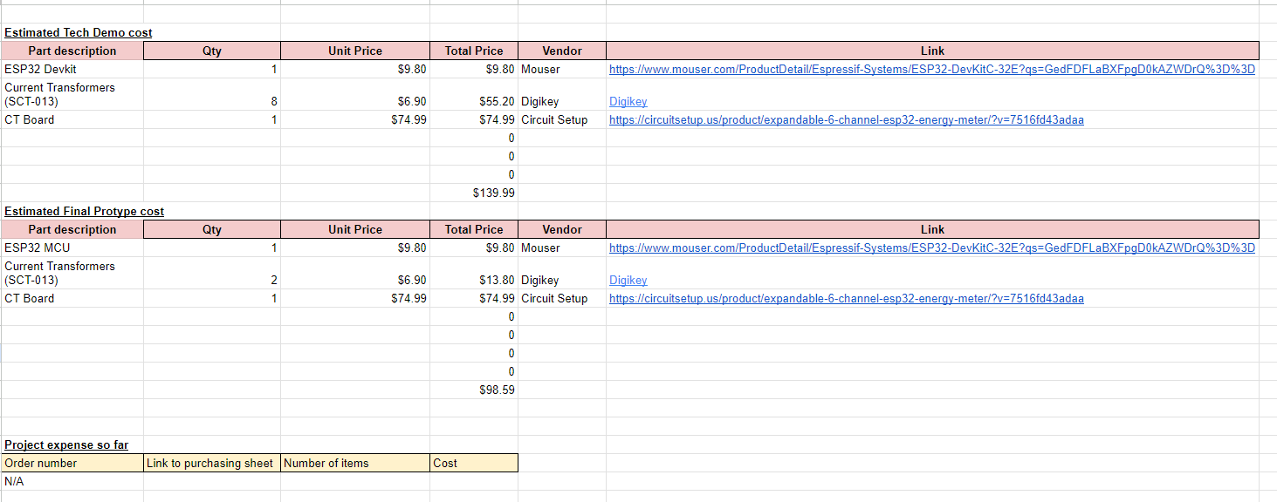
Project Budget Status
Team Charter - 50_ResidentialPowerDisaggregation_Fall_2023

Slide 19
Questions
and
Discussion
Notes:
Slide template from slides.com

